Slide 1


Dhru Shah
GitHub: @DStheDS
May 2023

Slide 2


Outline
Executive Summary
Introduction
Methodology
Results
Conclusion
Appendix

Slide 3

Executive Summary
Summary of methodologies
Data had to be collected from SpaceX both by API and web-scraping
Data were wrangled and a landing class outcome derived
EDA was conducted to determine which variables in the dataset would be good predictors
Interactive visual analytics were generated and the predictive analysis was conducted on several classification algorithms to determine which would be best suited to the needs of SpaceY
Summary of all results
Lower Payload masses improve landing outcomes
Successes increase over time with gradual improvement
Decision trees are awesome

Slide 4
Executive Summary
SpaceX can reuse the first stage of their launches only if they can get the first stage to land successfully.
Reuse drastically lowers the price, so predicting successful landing outcomes for future missions will be a good indicator of cost reduction.
SpaceY may be able to take on missions with high probability of landing at a lower price if we can successfully predict landings

Slide 5

Section 1

Slide 6


Methodology
Data collection methodology: Data collected using the SpaceX public API and scraped from SpaceX Wikipedia using the Beautiful Soup package
Data wrangling: Data were checked for missing values, had basic checks made and had a binary class variable derived from launch outcomes (outcome to be modelled)
Exploratory data analysis (EDA): EDA conducted using visualization in Plotly and Seaborn packages and SQL via SQL magic
Interactive visual analytics: Dashboard made using Folium and Plotly Dash to create pie charts and scatter plots
Predictive analysis: Successful landings were predicted using classification models
Data was split into training and testing sets
Models were trained including logistic regression, support vector machines, decision trees and k-nearest neighbours

Slide 7
Data Collection
Data were collected via the SpaceX API and the Beautiful Soup web-scraping package.
The SpaceX API contained data on longitude and latitude of launch sites as well as details of reuse of parts of craft.
The Web-scraping was conducted on the SpaceX Wikipedia page to obtain data on the payload and the customer as well as booster landing.
The following flowcharts neatly explain the processes underpinning the collection via the SpaceX API and the Beautiful Soup web-scraping package.

Slide 8
Data Collection – SpaceX API
GET HTTP request flowchart
Pl
Client to API flowchart
GET Request
Client
API
Request
Check URL
Error
Response
GET datafile
Response in JSON
https://github.com/DStheDS/IBMDSCapstone/blob/main/SpaceX%20Data%20Collection.ipynb

Slide 9
Data Collection - Scraping
GET HTTP request flowchart
Dataset creation flowchart
GET Request
Pandas dataframe
Launch data
Check URL
Launch dictionary
Error
BeautifulSoup parse launch tables
BeautifulSoup parse titles/headers
GET datafile
HTTP Response
BeautifulSoup package
HTML object
Launch tables were made by looping the parser over every row, with a separate list made for every column
https://github.com/DStheDS/IBMDSCapstone/blob/main/SpaceX%20Web-Scraping%20for%20Data%20Collection.ipynb

Slide 10
Data Wrangling
Data were first checked for missing values and variable types
Important value counts were taken of
Launches on each site
Occurrence of each orbit
Mission outcomes per orbit type
Landing outcomes were classified as successful or not, stored as derived variable Class
Data wrangling flowchart
Raw SpaceX dataset
Basic checks
Value counts
Wrangled data
Checks on outcome
Deriving outcome class variable
https://github.com/DStheDS/IBMDSCapstone/blob/main/SpaceX%20Data%20Wrangling.ipynb

Slide 11
EDA with Data Visualization
The EDA required producing many charts to make the basic checks on data
Scatter of Launch Site vs Flight Number to check if launch site changes by flight number
Scatter of Launch Site vs Payload Mass to check if certain launch sites take missions with heavier payloads
Bar chart of Success Rate by Orbit Type to check which orbits have the least/most successes
Scatter of Orbit Type vs Flight Number to check if orbit type changes by flight number
Scatter of Orbit Type vs Payload Mass to check if certain orbits have missions with heavier payloads
Yearly success trend line to check for success over time
https://github.com/DStheDS/IBMDSCapstone/blob/main/SpaceX-eda-dataviz.ipynb.jupyterlite_ds.ipynb

Slide 12
EDA with SQL queries - breakdown
All Launch Site Names
Cases from Launch Sites with Names Beginning with 'CCA'
NASA Missions Total Payload Mass
Average Payload Mass for Booster F9 v1.1
First Successful Ground Landing Date
Successful Drone Ship Landing with Payload between 4000Kg and 6000Kg
Total Number of Successful and Failure Mission Outcomes
Boosters that Carried Maximum Payload
2015 Failed Drone Ship Launch Records
Rank of Landing Outcomes Between 2010-06-04 and 2017-03-20
https://github.com/DStheDS/IBMDSCapstone/blob/main/SpaceX-eda-sql-coursera_sqllite_ds.ipynb

Slide 13
Build an Interactive Map with Folium
There were many markers, lines, circles and lusters added to the Folium map
Explain why you added those objects
Circles were added to mark each of the Launch Sites on the map
Clusters were constructed to show the number of launches geographically, which changes depending on the zoom
Markers were added for each launch (they show on clicking the site) and labelled by colour - green for success red for fail – to show the successes and failures by site
Lines were added to the map to mark out distances (along with the distances themselves) to the nearest highway, railway, city and coast to check for the influence of site placement on success.
https://github.com/DStheDS/IBMDSCapstone/blob/main/SpaceX_Folium_maps.ipynb

Slide 14
Build a Dashboard with Plotly Dash
The Plotly Dashboard had interactivity built into its display of graphs
Interactions
Launch Site was added as a dropdown menu so that graphs can be seen for specific sites
Payload mass was added as a slider to set the range for the scatterplot because the flights are not evenly distributed by mass and it may be of interest to investigate specific ranges of payload mass
Plots
A pie chart of Launch success as percentage was added to compare success rates by site, the all sites option shows the share of successes for each site
A Scatter plot of Payload Mass vs Launch Outcome was made to check for the influence of the payload mass on success. This was coloured by booster version to check if different boosters have different relationships to payload mass
https://github.com/DStheDS/IBMDSCapstone/blob/main/DS%20SPACEX%20DASHBOARD.py.txt

Slide 15
Predictive Analysis (Classification)
Classification flowchart
Algorithm comparison flowchart
SpaceX dataset
Algorithm with Grid Search
SpaceX dataset
Basic checks
Preprocessing with standard scaler
no
Choose next Algorithm
Evaluate:is model ok?
Basic checks
Split into test and training
data
Training data
Grid Search on chosen algorithm
yes
yes
Preprocessing with standard scaler
Test data
Another algorithm to check?
Evaluate model performance
Best model
no
Best model
https://github.com/DStheDS/IBMDSCapstone/blob/main/SpaceX_Machine_Learning_Predictions.jupyterlite_DS.ipynb

Slide 16

Results
Exploratory data analysis results
Success improves over time (thank goodness)
The KSC launch Site takes missions with heavier payloads
Nearly all mission outcomes are a success
Interactive analytics demo is shown in screenshots
The site with the highest success rate is the KSC
Missions with lower payload mass are more common and have more successful landings
Predictive analysis results
The decision tree was the best model
All models predicted with the same accuracy

Slide 17

Section 2

Slide 18
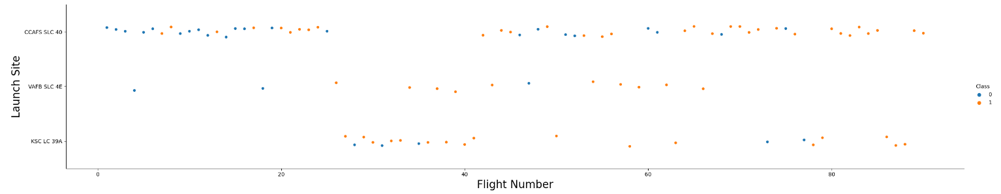


Flight Number vs. Launch Site
VAFB SLC 4E is a largely successful but rarely used site, while the other sites seem to be used in clusters
There is a generally an increase in the number of successes for higher flight numbers.

Slide 19
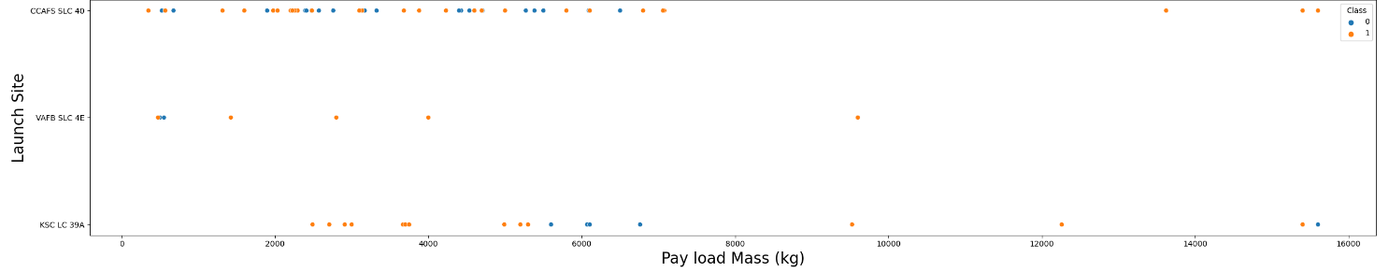
Payload vs. Launch Site
Most payloads have been under 6000Kg, with very few over 8000Kg
Launches from site KSC LC 39A have generally had to carry heavier loads
There have been 3 successes with loads over 15000Kg so it is very possible to carry out more missions with heavy loads
Payload Mass does not seem to have an easily visible relationship to success rate – each mission success is most likely dependent on preparing for its own parameters

Slide 20
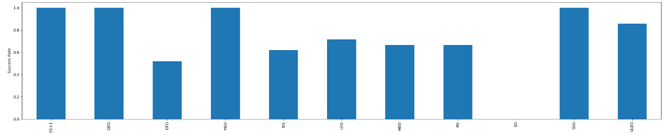
Success Rate vs. Orbit Type
Many orbit types have high success rates: Equilibrium with the Sun Lagrange, Geosynchronous, Highly Elliptical and Sun-Synchronous orbits. Note that these all have geometric or gravitational relationships with the planet
The orbit that matches Earth's rotation (GTO) as well as Lower, Middle and Polar Orbits have lower success rates
As seen before SO only has one occurrence and SSO has only 5 so they are not reliable as indicators of performance for Sun-synchronous orbits yet

Slide 21
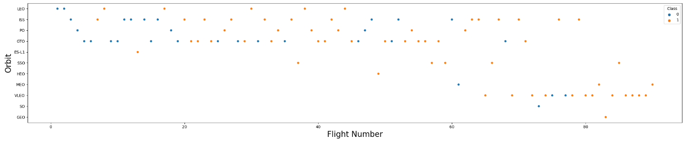
Flight Number vs. Orbit Type
VLEO, SO and SSO have become more popular on higher flight numbers where they were not used at all on smaller flight numbers
LEO and PO orbits are less popular at higher flight numbers
ISS and GTO Orbits became more successful at higher flight numbers

Slide 22
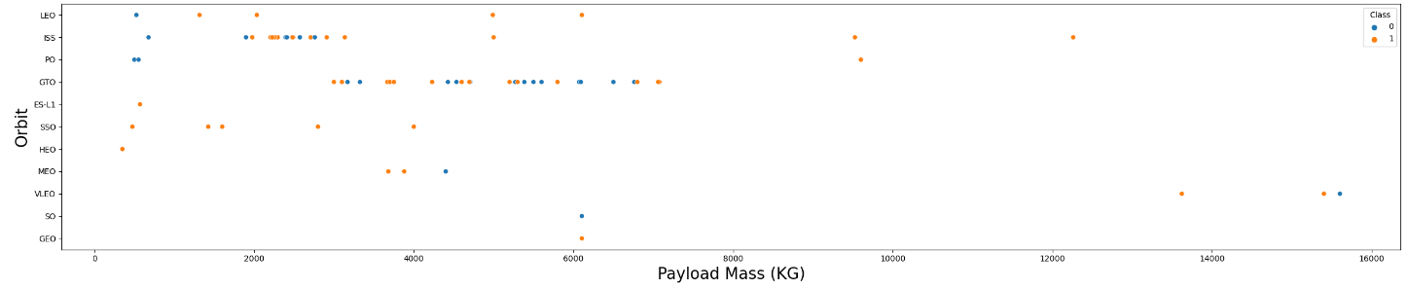
Payload vs. Orbit Type
VLEO have carried the most Payloads above 12000Kg and have been successful
GTO have a narrow range of Payload masses around 3000-7500Kg
There is a large cluster of similar masses for ISS
Lower masses appear to be more successful at higher orbits (need more data to confirm)

Slide 23
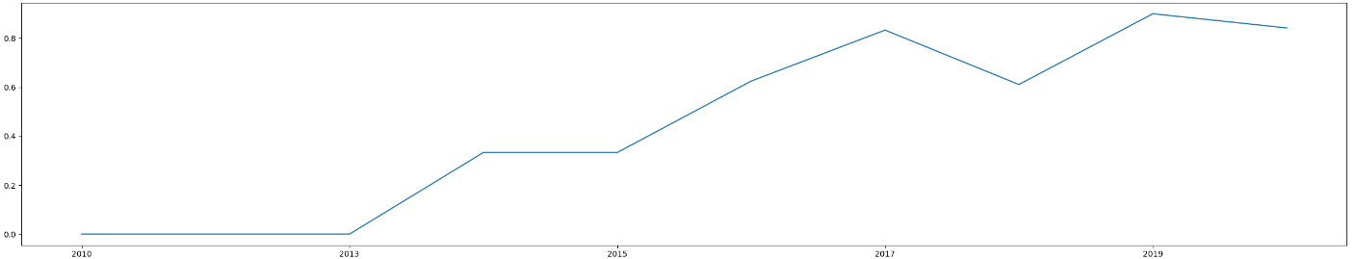
Launch Success Yearly Trend
This shows the yearly average success rate
Even without any success up to 2013, success rate came above 80% in 2017 – just 4 years
Rapid increase in success rate between 2015 and 2017
Not too far to 100%!

Slide 24
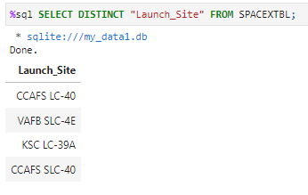
All Launch Site Names
This query finds the names of the unique launch sites
There are 4 separate sites, names are displayed.
There are two names that are very similar (first and last)

Slide 25
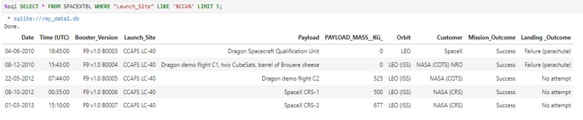
Launch Site Names Beginning with 'CCA'
This query finds 5 records where launch sites begin with `CCA`
The CCA sites' early launches seem to be dominated by CCAFS LC-40 with NASA as a customer

Slide 26
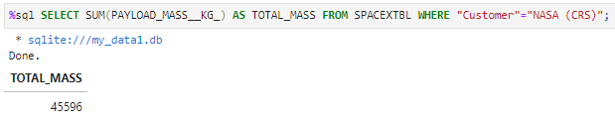
Total Payload Mass
The total payload carried by boosters from NASA is 45596KG - impressive
There have been many missions with NASA as a customer so the total mass of the payload adds up over the years

Slide 27
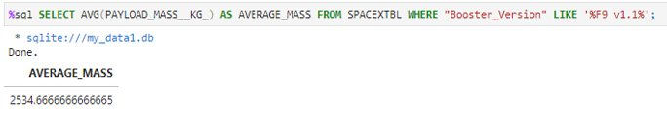
Average Payload Mass for Booster F9 v1.1
The average payload mass carried by booster version F9 v1.1is 2534.67KG

Slide 28
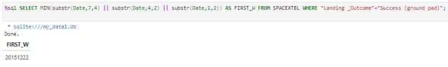
First Successful Ground Landing Date
This query finds the dates of the first successful landing outcome on ground pad
This date is December 22nd 2015 – just in time for Christmas

Slide 29
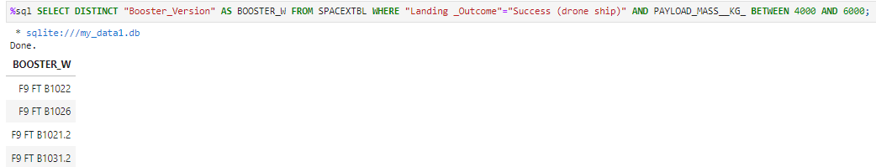
Successful Drone Ship Landing with Payload between 4000 and 6000
This query lists the names of boosters which have successfully landed on drone ship and had payload mass greater than 4000 but less than 6000
Their names are displayed above
They are all F9's – impressive accuracy to land on drones

Slide 30
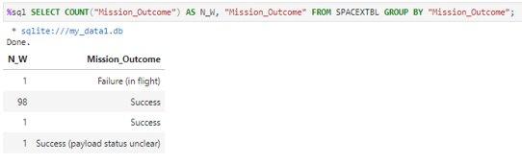
Total Number of Successful and Failure Mission Outcomes
This query calculates the total number of successful and failure mission outcomes
For some reason there are two types of success
There is only one failure and it occurred in flight
Clearly not all successful missions successfully landed – landing is not everything

Slide 31
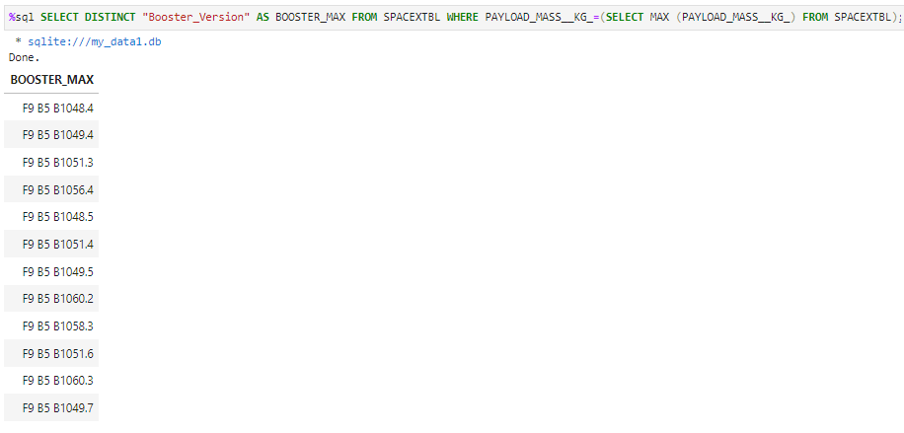
Boosters that Carried Maximum Payload
This query lists the names of the booster which have carried the maximum payload mass
F9 B5 boosters with different version numbers
This is the booster that appears to have been chosen to carry heavy loads

Slide 32
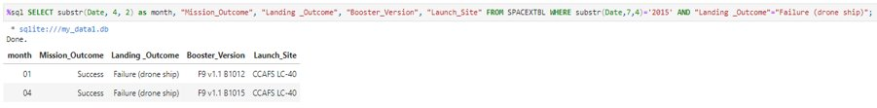
2015 Failed Drone Ship Launch Records
This query lists the failed landing_outcomes in drone ship, their booster versions, and launch site names for in year 2015
Both of these were conducted at the same site on F9 v1.1 boosters
Their mission outcomes are still successful, indicative of the growth mindset that now has F9 v1.1 working with more successes

Slide 33
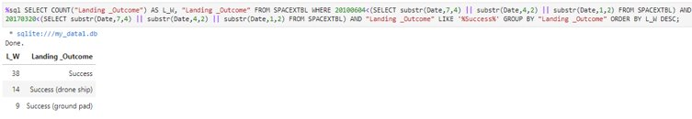
Rank of Landing Outcomes Between 2010-06-04 and 2017-03-20
This query ranks the count of landing outcomes between the date 2010-06-04 and 2017-03-20, in descending order
A generic Success is by far the most common with 38, where the ground pad landings are the least common just 9 of them

Slide 34

Section 3

Slide 35
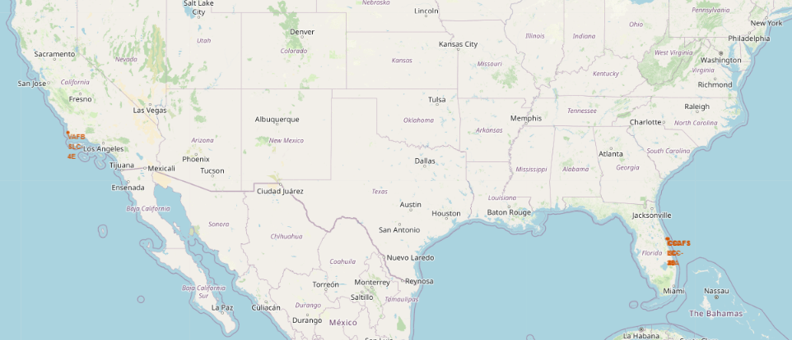
Launch Site locations
There are three launch sites in Florida and one in California
Two of the sites CCAFS LC-40 and CCAFS SLC-40 are very close to each other
So far all sites are in the US – here's to hoping we can go global!

Slide 36
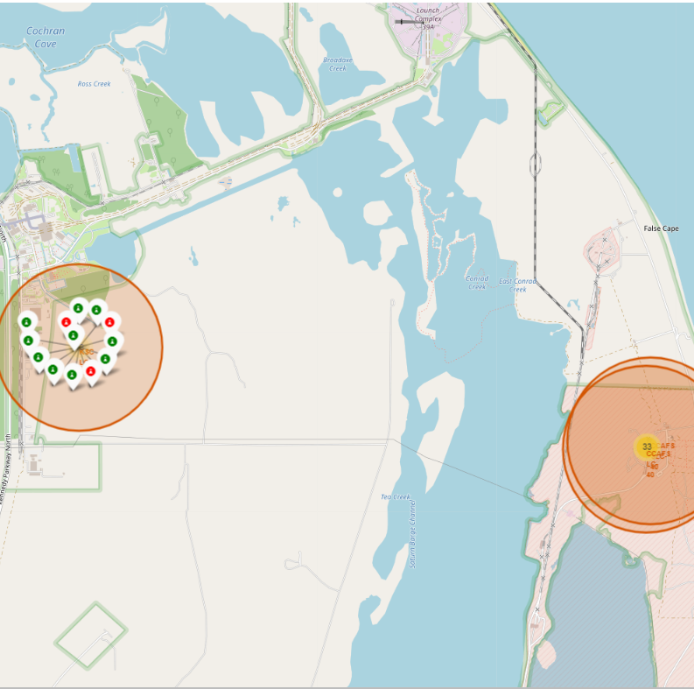
Successful launches on a site
The chosen site KSC LC-39A has 13 launches, 10 of which were successful – very good
Successes are in green, failures are in red
The map will display this when the site circle is clicked on

Slide 37
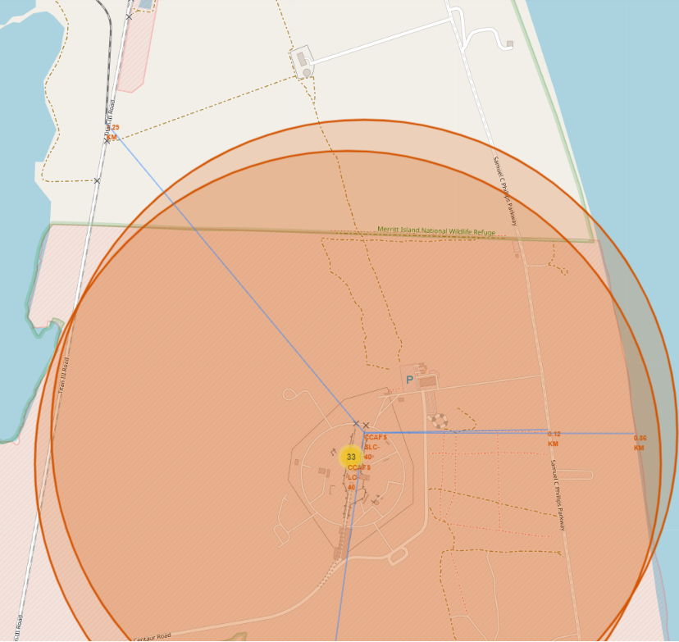
Proximity of Launch Site to key areas
The chosen site is CCAFS SLC-40
The highway is 0.72KM away
The coast is 0.86KM away
The railway was 1.29KM away
The close proximity to all of these important transport areas means that people, materials and equipment can move to and from the site easily

Slide 38
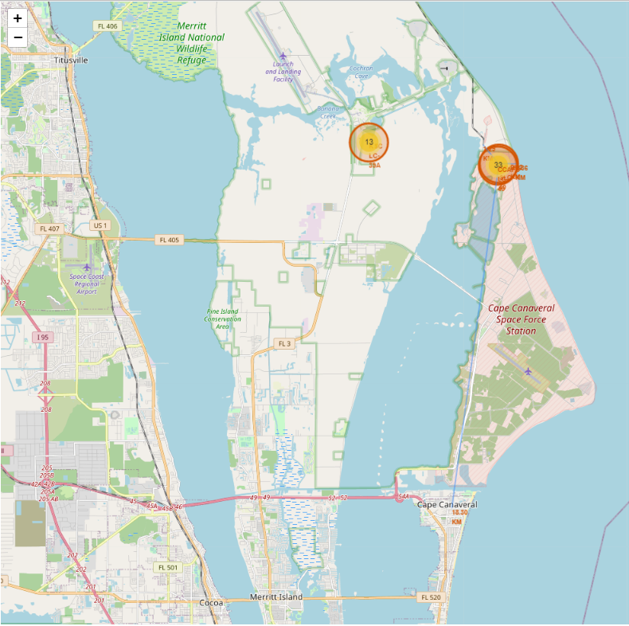
Proximity of Launch Site to key areas
The chosen site is CCAFS SLC-40
The nearest urban area is over 18KM away
This is likely due to noise and air pollution for launches and the need for lots of space
You can see the clustering of launches from this distance on the map

Slide 39

Section 4

Slide 40
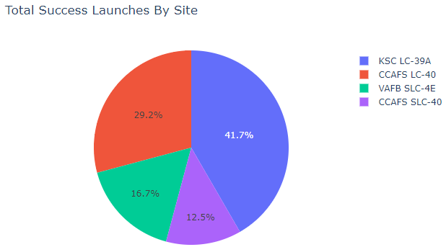
Launch successes by site
The least successful Launch site so far is CCAFS SLC-40
The most successful Launch site so far is KSC LC-39A
Note that this is represents the share of successful launches by site, not the rate of success for each site, hence CCAFS LC-40 seems also to be doing well

Slide 41
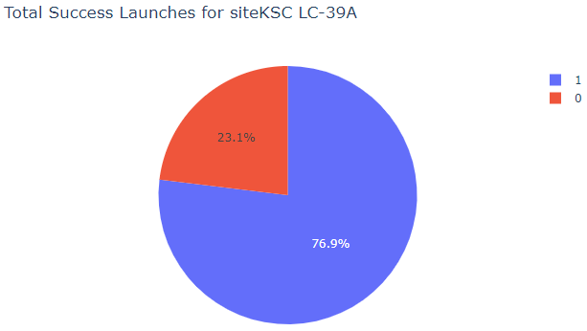
Most successful launch site
The site with the highest success rate is KSC LC-39A with 76.9% of launches successful – this is impressive

Slide 42
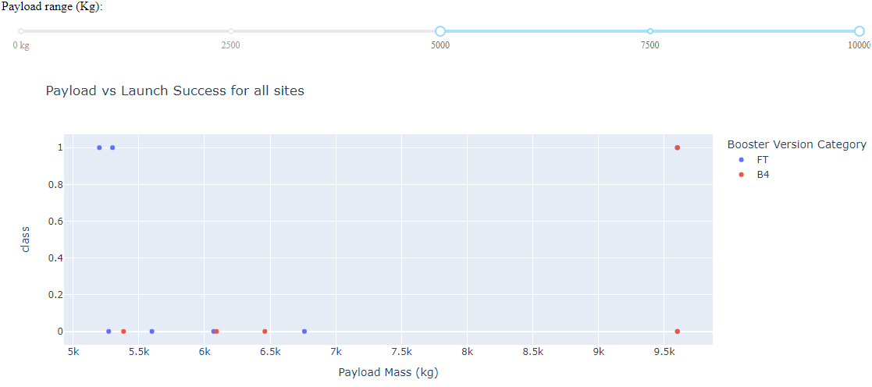
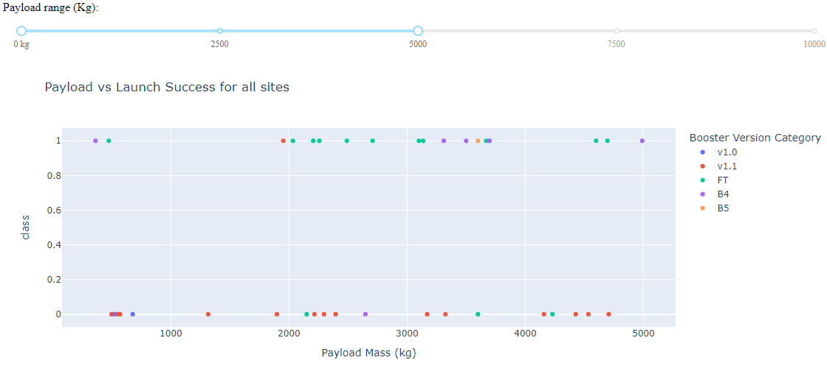
Payload and Booster Version vs Launch Outcome
Payloads above 5,000KG have only been attempted with boosters FT and B4, only 3 have been successful though, but one of those is at nearly 10,000Kg so it can be done!
Payloads below 5,000KG have been more successful, with the FT booster version having the highest number of successes and V1.1 having the lowest, performing poorly with heavier payloads

Slide 43

Section 5

Slide 44
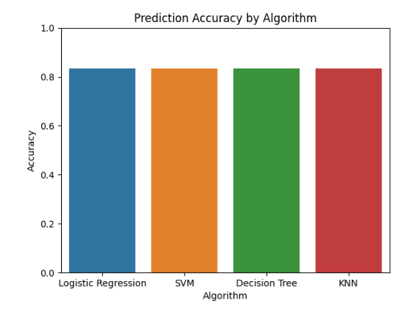
Classification Accuracy
This bar chart shows the accuracy score for all Algorithms used to model successful landings.
They are all just as accurate as each other!

Slide 45
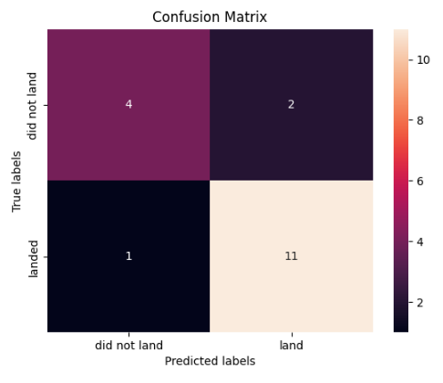
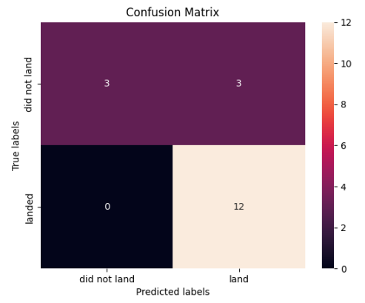
Confusion Matrix
Confusion Matrix for Decision tree
Confusion Matrix for Regression
Both of these models are equally good at predicting the outcomes but the decision tree produces fewer false positives and the regression produces fewer false negatives

Slide 46
Conclusions
SpaceX will likely not be launching craft into the 100,000's so when using models to predict successful landings it is better to keep it simple using models like Logistic Regression and Decision Trees.
Both of these are relatively easy to interpret whether in terms of odds ratios or in terms of which craft on which missions are predicted to land from which launch sites by the decision tree.
The models also have the added bonus of being faster to train and predict, so iterating to refine the models or adding in new data will be easier should it be deemed necessary.
Out of regression and decision trees it is better to use the decision tree. This is because:
The decision tree produces fewer false positives, which is better for business in the long run as fewer unpredicted crashes means more money and craft saved – and hopefully makes it safer for manned craft one day
Decision trees can capture non-linear relationships between predictor and outcome variables without having to fit a polynomial, which makes them less prone to error and easier to interpret.

Slide 47
Appendix
All relevant assets like Python code snippets, SQL queries, charts, Notebook outputs, made during the project are saved in this repository: https://github.com/DStheDS/IBMDSCapstone
You will also find this PowerPoint there

Slide 48


